Slide 1



Git 201 - A Deeper Look at Git
Git Me With Your Best Shot
Arthur Doler
@arthurdoler
arthurdoler@gmail.com

Slide 2





































TITANIUM SPONSORS
Platinum Sponsors
Gold Sponsors

Slide 3
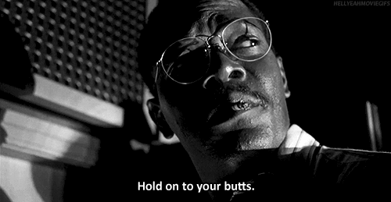
We’ll be using the Git command line…
Source: Giphy

Slide 4
“Fundamental particles” of Git

Slide 5
Blob
artdoler@machine$ git ls-files --stage
100644 ac461d89cb0a217c2ee2bfcac33e1c27df7739a7 0 path/to/source/file.js

Slide 6
Tree
artdoler@machine$ git write-tree
cf09c37fdb1e4ba320d2ae08e9eb32d6913979e3
artdoler@machine$ git ls-tree cf09
040000 tree c98ef89a1fc979e593927666c058d15f8111c0bf path

Slide 7
Commit
artdoler@machine$ echo "Manual commit." | git commit-tree cf09
c26db2aec27b78aeaed82173ec5f5b2303931b29
artdoler@machine$ git log c26d
commit c26db2aec27b78aeaed82173ec5f5b2303931b29
Author: Art Doler art.doler@aviture.us.com
Date: Thu May 20 08:59:12 2016 -0500
Manual commit.
Notes:
A quick overview of the basic structure for git – blobs are contained by trees, which contain each other, and which are contained by a commit.
Blobs and trees are subatomic particles, composing the literally atomic commits. Like reality, almost all of the time, just knowing how atoms work is enough. Sometimes there’s effects that make no sense which require subatomic knowledge, but until those points it’s not necessary.

Slide 8
A Git repository is just graphs of commits

Slide 9
Blob
Δ
Δ
Tree
Δ
Δ
Δ
Commit
Δ
Δ
Δ
Δ
Δ
Δ
What Git Manages For You
Δ
Δ
What To Actually Think About
Notes:
Commits and commit topologies are the most important pieces of Git. The “atomic” commits form into “molecules” of topologies (typically called branches).
The edges of the DAG are then the deltas.

Slide 10
How does Git make diffs?

Slide 11
Rename
Commit 1
Commit 2
File 1
A
File 2
Delete
Directory
Directory
B
File 3
File 4
File 4
C
E
File 5
Edit
Add
F
Notes:
Here we have two commits, side by side, and we’re going to try to get a diff between the two.
Commit 1 has three files – one in the root of the repo (File 1) and two in a directory (helpfully called Directory), which are File 3 and File 4.
Commit 2 has three files – File 2 in the root and File 4 and File 5 in Directory.
File 1 and 2 have the same blob: identically the same. Git will (sometimes) reinterpret this as a rename.
File 3 is in Commit 1 but not in Commit 2, so it’s a delete.
File 4 has different blobs in the two commits: it’s a change and a diff will be generated.
File 5 is in Commit 2 but not in Commit 1: it’s an add.

Slide 12

Branches & Tags
Source: Giphy
When I realize “DVCS” means I always get my own branch
Notes:
Time to go to the command line.
Explain what you’re doing – committing data to be served via a service. In this case, MTG decks. Magic has different ways to play it, called “formats”. We’re tracking formats in different branches, because Reasons.
New tournament – block format! So “git checkout –b mtg_2014_block”
There are uncommitted changes, so “git add .” then “git commit –m “New decks.””
Talk about what a branch is – a pointer to a specific commit.
A major tournament is over so we’re making a tag for it. “git tag –a SCG_Open_07_2014 –m “SCG Open Finalized Decks.””
Lightweight tags are just like (mostly) immutable branches. Annotated tags identify the tagger, the message, the date, and have a checksum.
Talk about how a branch is actually a pointer to the entire DAG (directed acyclical graph) at that point. Two important things to realize:
A branch is not constrained by anything – any branch can point to any commit (even HEAD or master!).
The hash for each commit includes its parent – that means ANY history change will cascade through the DAG! We’ll see an example when we rebase.

Slide 13
What’s in a name?

Slide 14
HEAD
feature/my_feature_branch
ac461d89cb0a217c2ee2bfcac33e1c27df7739a7
^ ~

Slide 15
A = A^0
B = A^ = A~ = A^1 = A~1
C = B^ = A^^ = A~~
C = A^1^1 = A~2
C ≠ A^2
C
B
A
develop
Notes:
Different ways to get upstream in your repository… note that these work on ANY name for a commit! And they can be chained, like in the last example, since the valid names for a commit (sha1, tag, branch, etc) plus the ^ and ~ operators are a valid DSL.

Slide 16
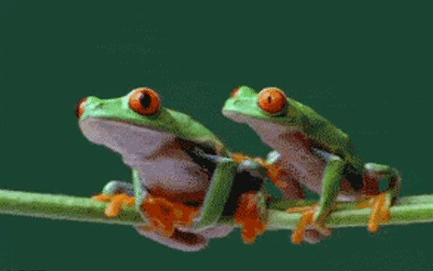
Merging
Source: Giphy
When my coworker’s merge breaks my feature
Notes:
Anything valid in block format is valid in standard format, and so we need to merge those commits in: “git checkout mtg_2014_standard”, “git merge --no-ff mtg_2014_block”
The “no-ff” option on a merge performs a guaranteed merge commit – by default git will try to avoid making a merge commit if it can, through doing what is basically a rebase. –no-ff forces it to make a merge commit instead.

Slide 17
A = A^0
F
G
B = A^ = A~ = A^1 = A~1
C = B^ = A^^ = A~~
C = A^1^1 = A~2
C ≠ A^2
D
E
develop
branch_2
C
D = C^1 = C~ = B~2
B
E = C^2 = B^^2 = A~2^2
F = C^^ = A~4
A
develop
G = E~ = C^2^ = A~2^2~
Notes:
Different ways to get upstream in your repository… note that these work on ANY name for a commit! And they can be chained, like in the last example, since the valid names for a commit (sha1, tag, branch, etc) plus the ^ and ~ operators are a valid DSL.

Slide 18

Opinion Time
Source: Giphy

Slide 19
If the best way to think about Git is commit topologies…

Slide 20
One Concept, One Commit

Slide 21
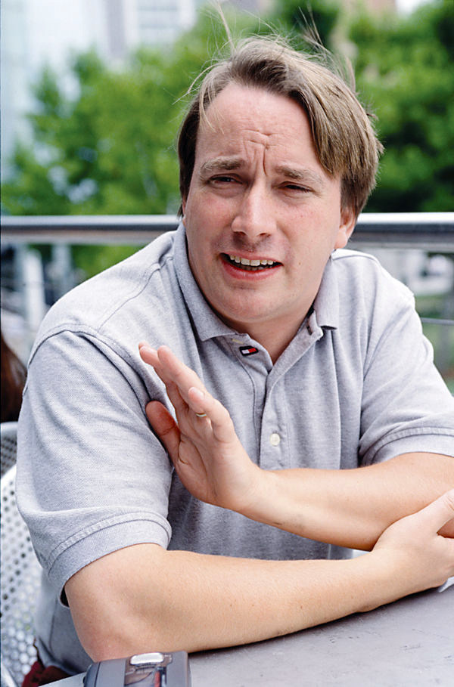
“I don't know how many people look at Al's progression of patches, but they are stand-alone patches on their own, while at the same time _also_ being part of a larger migration to the inscrutable goals of Al - ie namespaces etc.
You may not realize just _how_ impressive that is, and what a absolute wonder it is to work with the guy.
Poetry in patches, indeed.”
- Linus Torvalds
On fa.linux.kernel, 27 Dec 2001
Source: Wikipedia

Slide 22
Clean code ↔ Clean history

Slide 23
Pick “too many commits” over “too few”

Slide 24
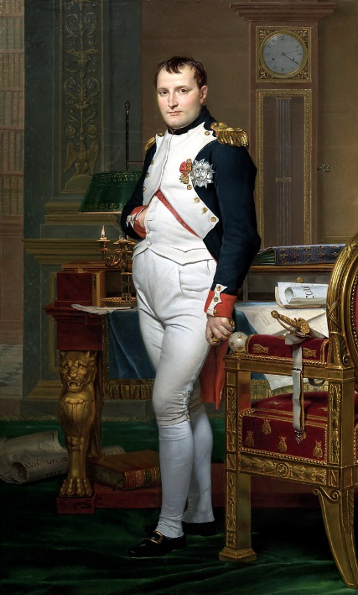
“History is the version of past events that people have decided to agree upon.”
- Attr. Napoleon Bonaparte
Source: Wikipedia

Slide 25
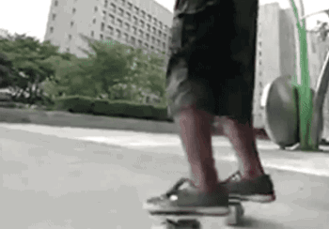
Rebasing
Source: Giphy
When you learn to rebase like a boss
Notes:
Example time yet again.
We have a repo. We’ve been doing on-the-ground reporting for a local tournament and we’ve made a bunch of commits as we went so we didn’t lose anything.
Could push this, but it looks terrible.
What to do? Rebase!
Interactive rebase – git pops open whatever editor we have configured. One row = one commit, in reverse order. It does this in an editor so you can copy and paste, and so you can change the command from “pick” to something else. Show the list in gvim next to the list in gitviz.
There is one reorder, then two fixups, then one commit to reword and one commit to amend.
What if there had been commits on block we had to worry about? Rebase to the rescue!
Normal rebase. Call out how it applies each commit in turn.
We could have done both at once (and we should have!) but I broke it apart for clarity.

Slide 26
Public versus Private Branches

Slide 27
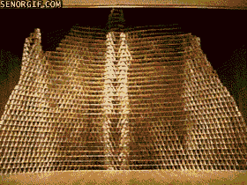
When you force push to a
public branch
Source: Giphy

Slide 28
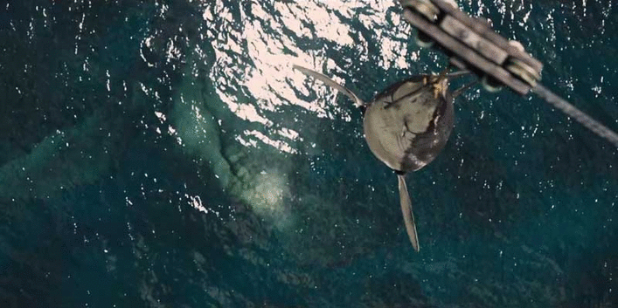
Garbage Collection
Source: Giphy
Finding out git has a garbage collector when it deletes your accidentally untracked branch
Notes:
Example time again.
git branch –D mtg_2014_legacy
./gcscript.sh
See!

Slide 29
History Methodologies

Slide 30
Pure Merge (i.e. gitflow)
Pure Rebase (Keep Branch or Delete Branch)
Rebase Then Merge
Rebase With Squash (Mild/Major)
Example Case:
Feature
D
F
…
A
E
…
B
Develop
Notes:
A discussion of git workflows – I’m going to exclude the issues caused by external tools here and focus only on git.
It – essentially – boils down to four types of git workflows.
We’ll work through the same example with each of the four types – just as a visual, to avoid a lot of unnecessary typing.

Slide 31
…
…
B
A
Develop
C
D
Pure Merge
E
Feature
F
G
Notes:
“Pure “ merge – using only the merge command (with --no-ff option). First merge develop into the feature to get the changes from Feature Branch B, accounting for conflicts if necessary. Then merge the feature branch into develop.

Slide 32
…
A
Develop
B
C
Pure Rebase
(Keep or Delete Branch)
D
Feature
Notes:
“Pure” rebase – First rebase the feature branch onto current develop to pick up branch B’s changes. Then alter develop’s head ref to point to F, either via manually editing it (bad!) or a fast-forward merge.

Slide 33
…
…
B
A
Develop
C
D
Rebase Then Merge
E
Feature
F
Notes:
Rebase then merge – First rebase the feature branch onto current develop to pick up branch B’s changes. Then merge feature back into develop, using a --no-ff merge, to retain the merge commit.

Slide 34
…
A
Develop
B
D
Rebase With Squash
E
Feature
F
Notes:
Rebase then squash – First rebase the feature branch onto current develop to pick up branch B’s changes. Then interactive rebase to squash to one or a few large commits. Then fast-forward merge feature into develop.

Slide 35

Questions?
When I accidentally click ‘Merge pull request’ instead of ‘Comment’ in GitHub
Source: Giphy
Notes:
??????

Slide 36
Do you live in the Omaha/Lincoln area?
Do you work in development or in another profession in tech?
Are you a consumer of mental health services or have you been diagnosed with a mental disorder?
Are you interested in being a founding member of a peer-support group for technical mental health consumers?
Talk to me afterward, or email me at arthurdoler@gmail.com
(or Twitter DM or LinkedIn message or G+ message…)

Slide 37
Resources

Slide 38
Git from the Bottom Up (free!)
http://ftp.newartisans.com/pub/git.from.bottom.up.pdf
Gitflow
http://nvie.com/posts/a-successful-git-branching-model/
A Git Workflow for Agile Teams
http://reinh.com/blog/2009/03/02/a-git-workflow-for-agile-teams.html
Git Team Workflows: merge or rebase?
http://blogs.atlassian.com/2013/10/git-team-workflows-merge-or-rebase/
Git Pro Book (also free!)
http://git-scm.com/book
Git pack files
http://git-scm.com/book/en/Git-Internals-Packfiles
http://stackoverflow.com/questions/5176225/are-gits-pack-files-deltas-rathe...
Notes:
SO MUCH STUFF TO READ, you guys. Seriously.

